Slide 1
Alternative Economics : a critique of political economy
Exchange and consumption (i)
Dr Julian Saurin

Slide 2
General Remarks
We’ve begun to see how a simple term such as “value” turns out to be rather complicated.
We also saw how no matter how many different examples of value we thought up it still didn’t clarify the concept of value for us. If anything, it added further confusion.
(We did agree at least, though, that money was one expression of value).
As noted before, academic work requires a lot of conceptual and theoretical work so that we can speak more precisely about those things that concern us.
Notes:
F

Slide 3
General Remarks (ii)
We’ll start with the question of
exchange
And then move on to the question of
consumption
We’ll also see how intimately connected these two processes are in modern society, such that it seems that exchange value expressed through consumption becomes the measure of all wealth.
Notes:
F

Slide 4
More on money as a value (i)
“The wealth of societies in which capitalist mode of production prevails appears as an immense collection of commodities.”
Marx, K. Capital, volume 1. Penguin Classics, Harmondsworth. p.125
What does he mean by this ?

Slide 5
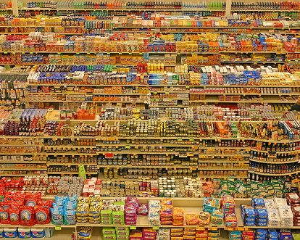
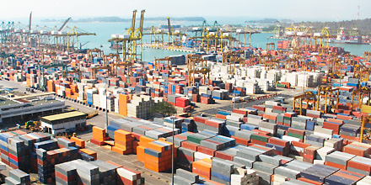
More on money as a value (ii)

Slide 6
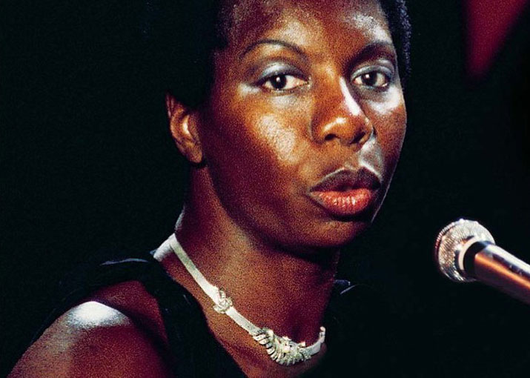
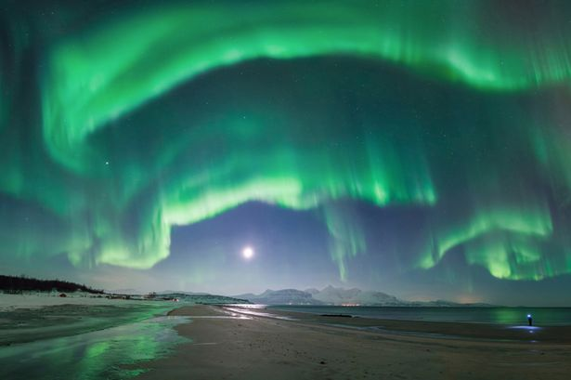
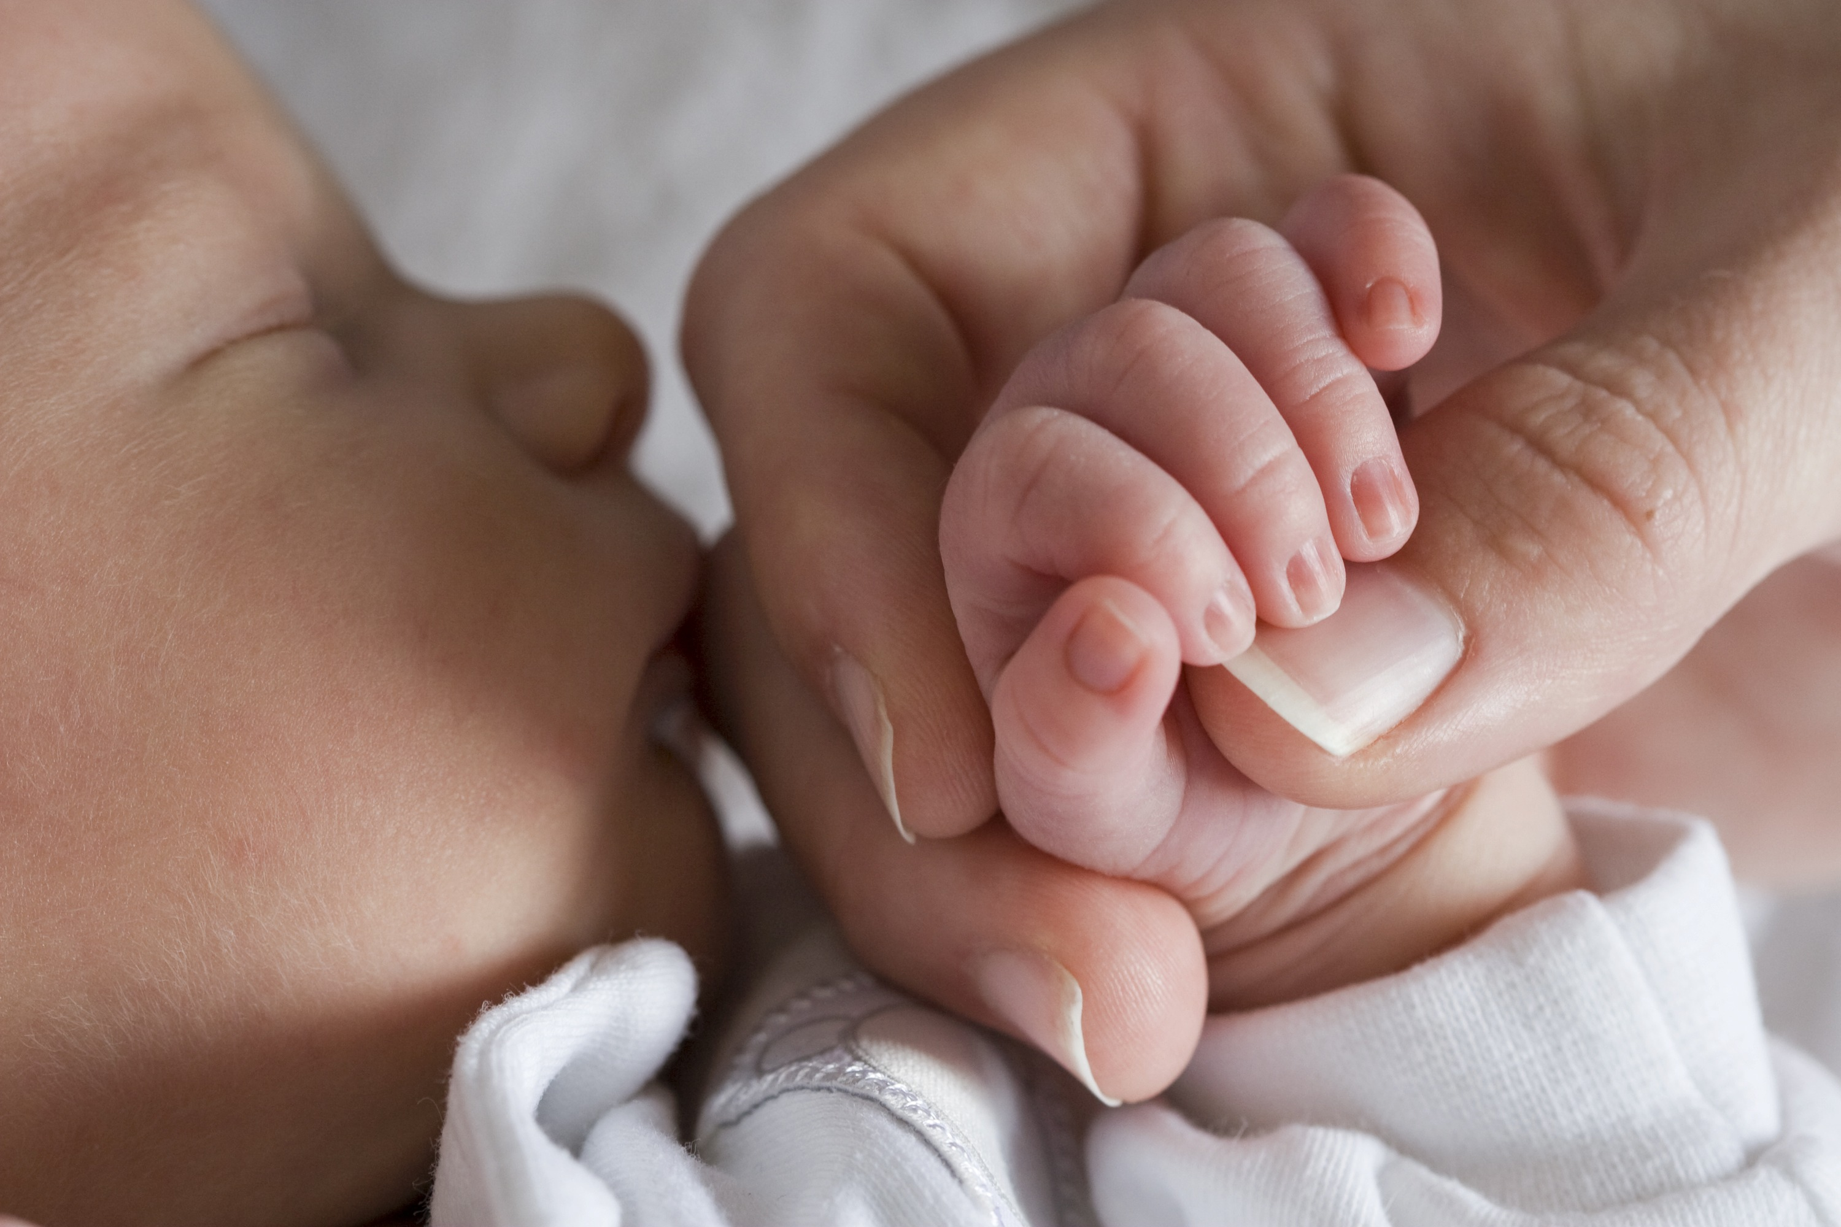
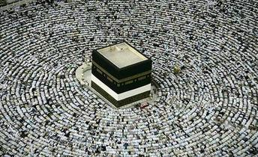
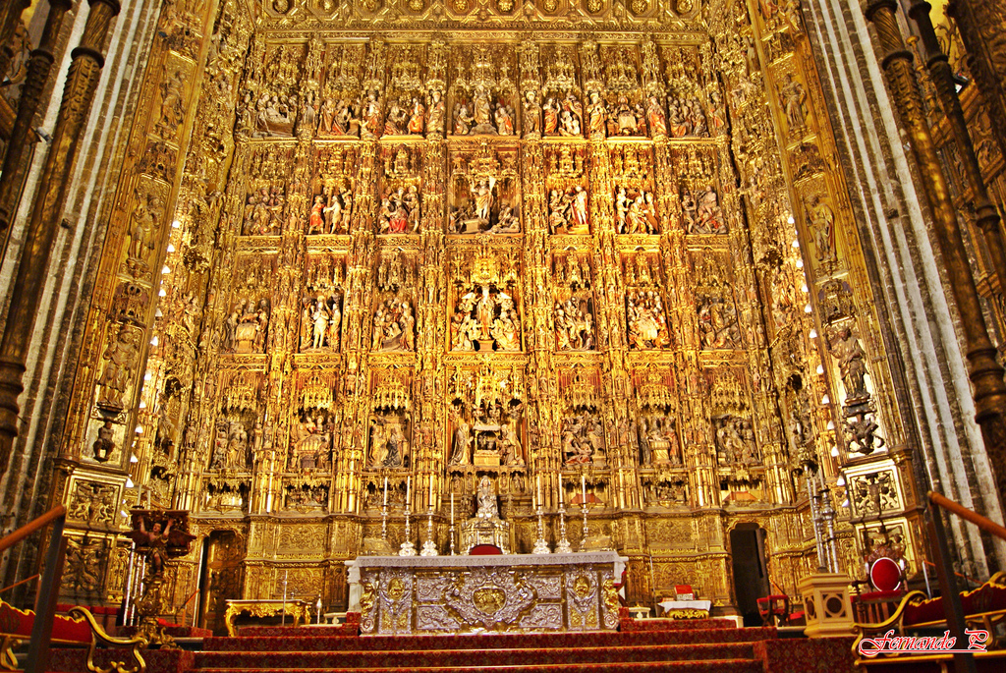
More on money as a value (iii)

Slide 7
“Exchange value appears first of all as the quantitative relation, the proportion, in which use-values of one kind exchange for use-values of another kind. This relation changes constantly with time and place.” Marx, K. Capital, volume 1. Penguin Classics, Harmondsworth. p.126
“… for instance 1 quarter of corn = x cwt of iron. What does this equation signify ? It signifies that a common element of identical magnitude exists in two different things… Both are equal to a third thing, which in itself is neither the one nor the other. Each of them, so far as it is exchange-value, must therefore be reducible to this third thing.”
Marx, K. Capital, volume 1. Penguin Classics, Harmondsworth. p.126

Slide 8
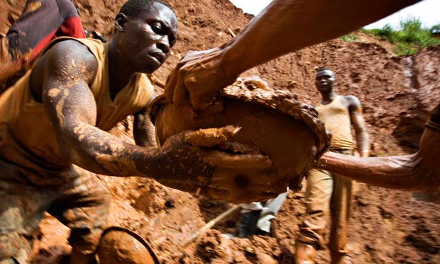
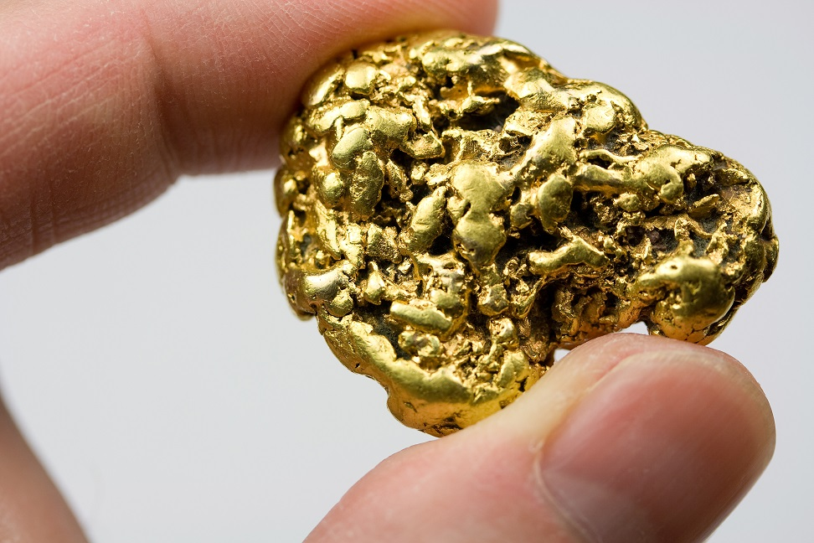
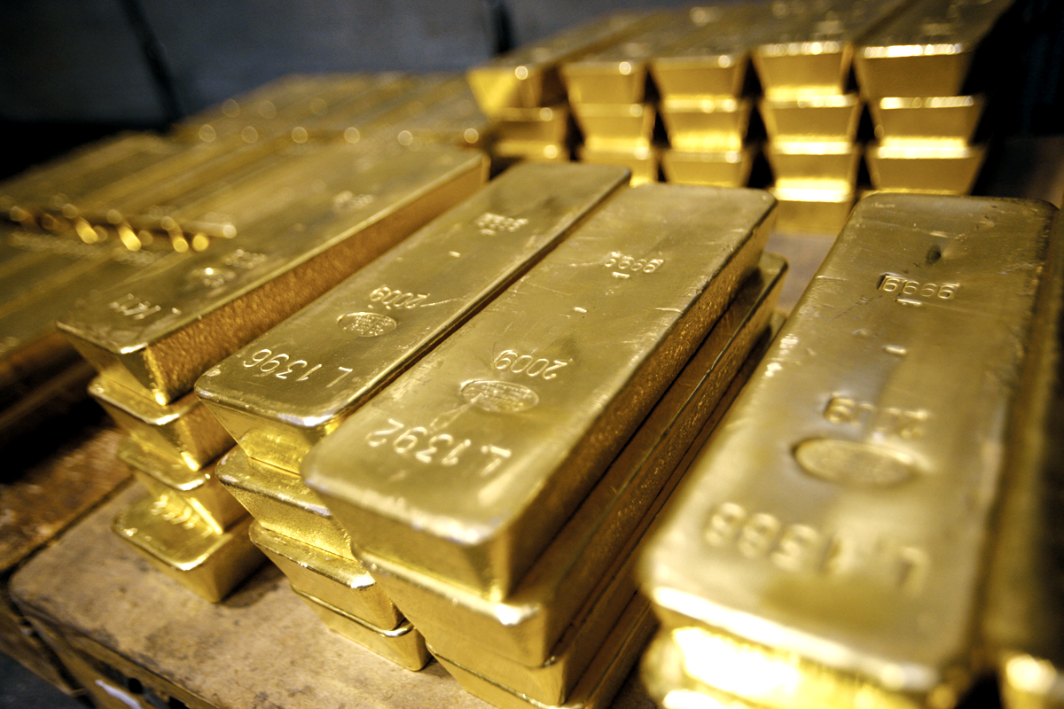
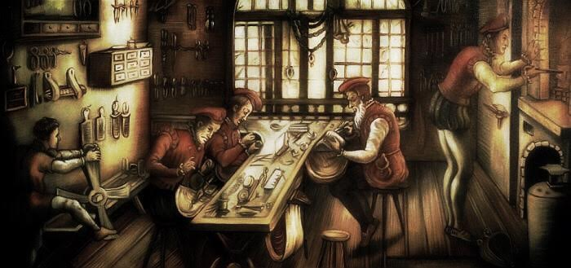
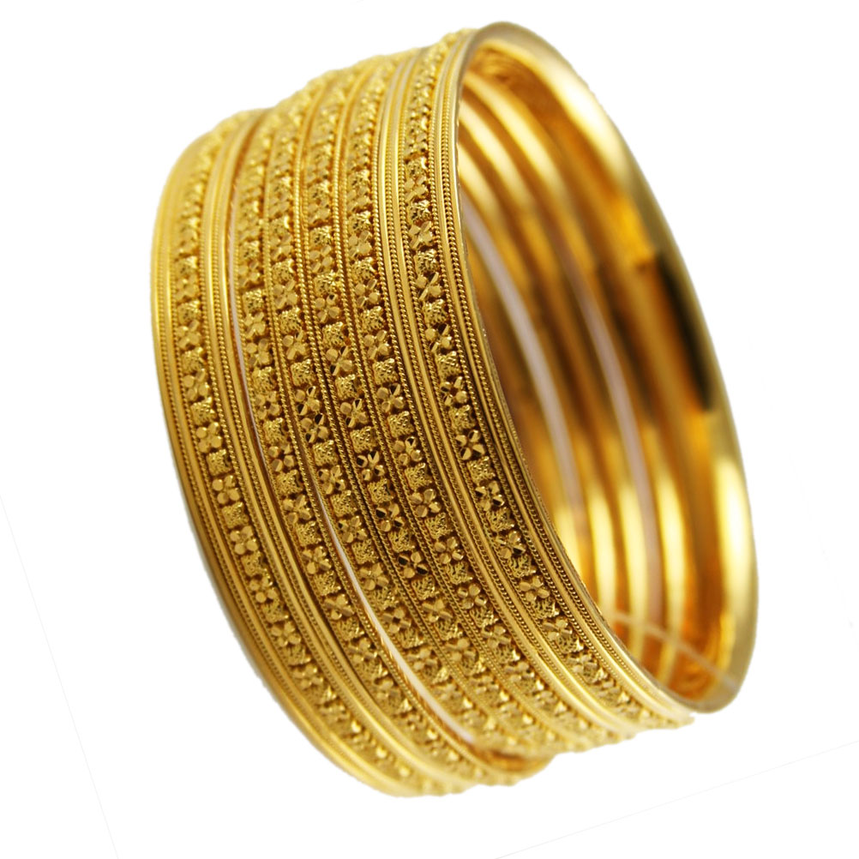
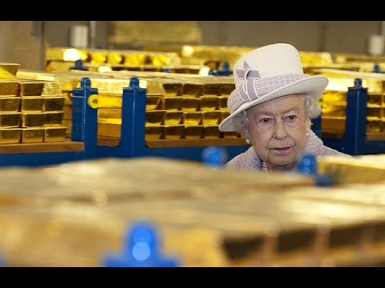
More on money as a value (iv)

Slide 9
Some circuits of capital
C = Commodity
M = Money
E = Exchange
C ➔ M ➔ C ➔ M ➔ C ➔ M ➔ C ➔ M ➔ C … etc
no increase in value
C ➔ M ➔^{E} C₁ ➔ M₁ ➔^{E} C₂ ➔ M₂ ➔^{E} C₃ ➔ M₃ ➔^{E} C4 … etc
buy low, sell high – increase in price yes; but increase in value ?

Slide 10
General formula of capital in Marx
M ➔ C ➔ M¹
C = Commodity
M = Money
L = Labour
MP = Means of Production
P = Productive Capital

Slide 11
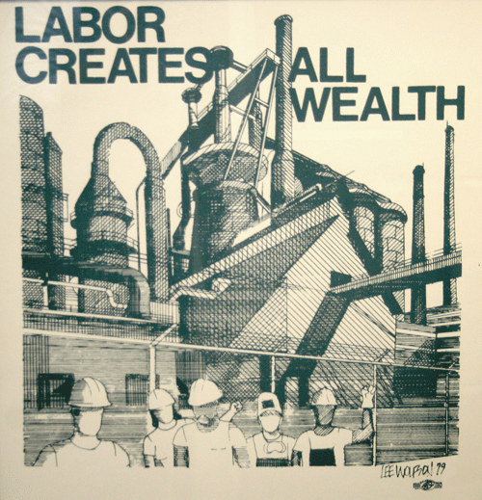
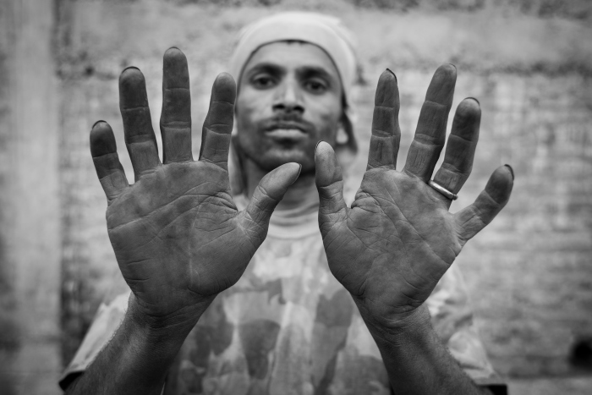
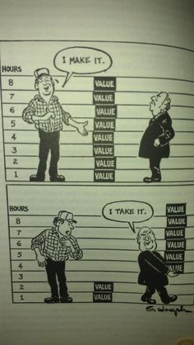
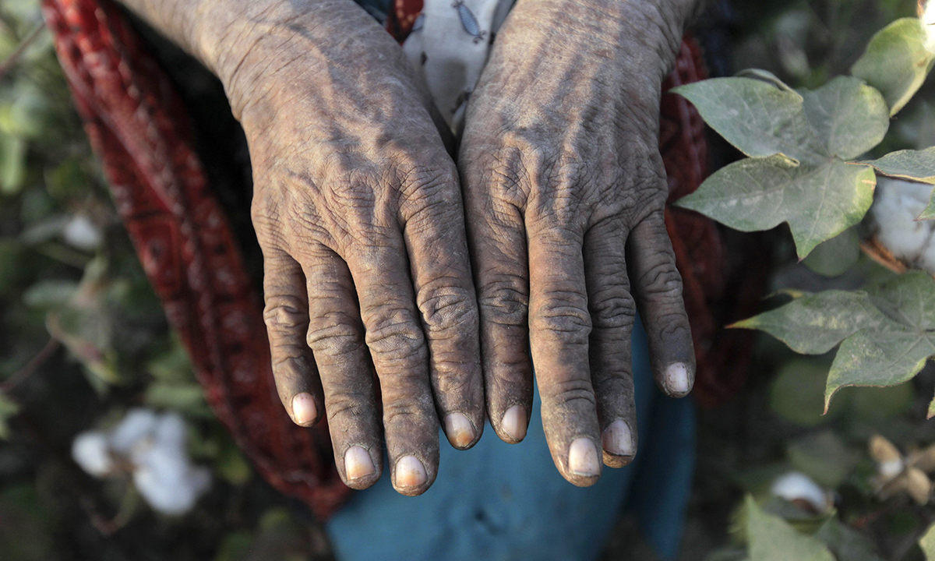
Labour theory of value

Slide 12
General formula of capital in Marx
Marx’s general formula for capitalist expansion or capitalist wealth production or production of capitalist value was that money (M) is advanced to purchase a commodity (C) in order to produce new commodities that are sold for a profit, creating more money. Let’s call that the simple moment or metamorphosis. Next, more complex moments and metamorphosis arise when with the commodities that have been purchased, the capitalist buys the means of production (MP) and labour-power (L), and insodoing transforms money capital into productive capital (P). It is the addition of labour-power which is crucial to the production of value.
C = Commodity
M = Money
L = Labour
MP = Means of Production
P = Productive Capital

Slide 13
Summary so far …
In this theory of value – known as the labour theory of value – the source of all wealth is to be found in labour.
But Marx doesn’t pluck that idea out of thin air. What is important about this theory and why we’ve spent time uncovering it, is because it is the way or mechanism by which value is produced by combining labour with commodities and exchanging them.
So, start with commodities; examine what they are, i.e, they have use value. Then see how they’re exchanged, and we see that commodities now have exchange value. Next all of those millions of exchange values can be expressed in one universal equivalent, i.e, money.
Finally, add labour power (and means of production i.e, tools) to produce new commodities of greater value.

Slide 14
How wealthy is an economy ? (i)
If we don’t know what value refers to we can’t know what wealth refers to ? That’s one reason that we need a theory of value.
Wealth can then be seen as an accumulation of those things that we value.
How wealthy are you, the simple individual ?
How wealthy is your family (however you define your family) ?
How wealthy is the street you live on, and the community you live in (however you define community) ?
How wealthy is your polis ?

Slide 15
How wealthy is an economy ? (ii)
In modern capitalist society wealth is measured in terms of the value of commodities put into monetary circulation. This is crucial.
Commodities may have great utility but if they have not been given exchange value i.e, have not been monetised then that value simply is not counted.
Let’s play a word game.
Here’s a new word :
capital
Sometimes a commodity, other times money, later labour, and then becoming machines, before turning into stocks and shares, as it turns back into raw commodities … and on and on the ceaseless metamorphosis of capital continues to convey value

Slide 16
The value of one word.
John works 40 hours per week, 49 weeks per year as a client relationship manager. He makes sure that his clients are well looked after, that they feel comfortable with the service provided, that they will return to John’s company for any future business that may arise. John is proud of his record in early identification and resolution of any problems and difficulties that his clients may experience. John takes care of his clients’ interests both responding to short term needs and long-term development. John is paid £50,000 per year plus bonuses.
Jane doesn’t work, she’s a stay-at-home mother. She makes sure that her children clients are well looked after, that they feel comfortable in the family, that they’ll appreciate their childhood years long after they’ve left home. Jane is proud of her skills and love as a mother, taking care of everything from her children’s coughs and colds to their education and career. She’s always there for them, and her children know that they can turn to Jane whenever they’re troubled or need help. Jane is paid £0 per year.

Slide 17
Money as a measure.
Clearly money has been used as a measure. Alternatively one can think of money as a unit of value. Let’s just think about measuring the value of an economy ? Take some basic categories such as GDP or size of debt or size of a corporation.

Slide 18
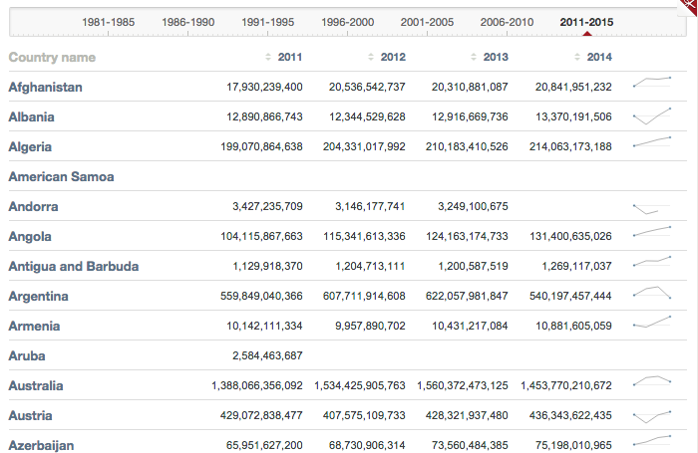
Measuring an economy (i)
Notes:
Quantitative statistical analysis of over 200 reports, studies and research from legitimate sources– in developed industrialised nations and 52 states of the US
Statistical analysis of the prevalence of the factors which impact upon health within societies
Statistical analysis of the prevalence of a range of other social problems/harms within societies
Combining this with data on levels of INCOME inequality within society – remember this is not rates of poverty but the difference between the poorest and wealthiest within society/state
Measurement of inequality they used was the 20:20 ratio - is to compare how much richer the top 20% of people are, compared to the bottom 20%.

Slide 19
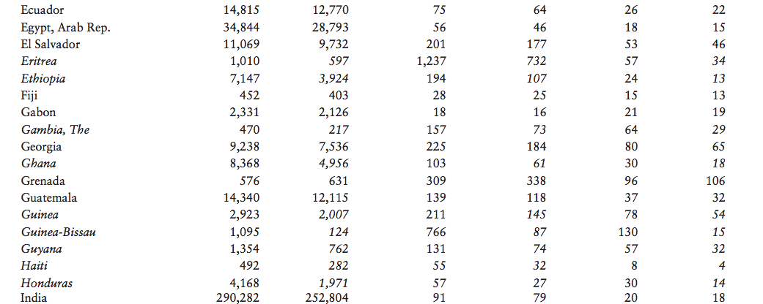
Measuring an economy (ii)
“The debt service ratio is the ratio of debt service payments made by or due from a country to that country’s export earnings.”

Slide 20
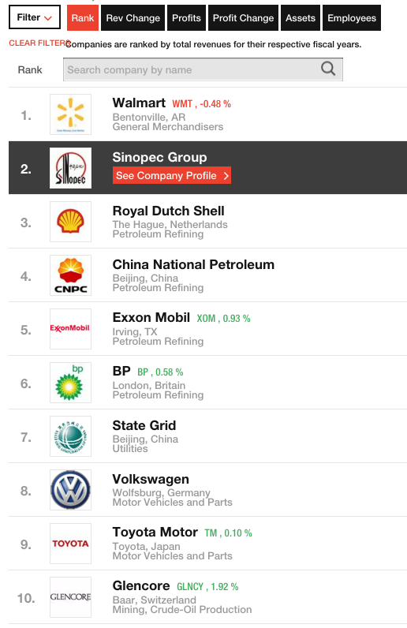
Measuring an economy (iii)

Slide 21
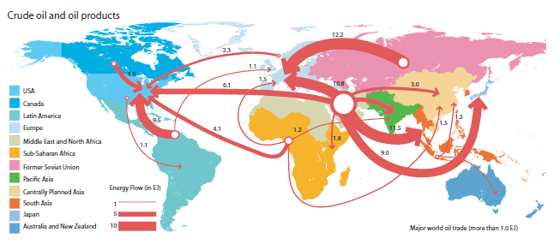
Exchange of energy
Source : http://www.sankey-diagrams.com/tag/trade/ from Global Energy Assessment 2012. IASSA.

Slide 22
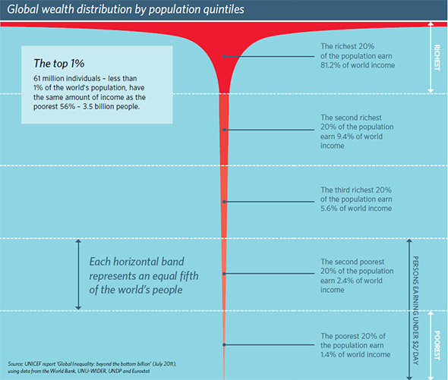

Slide 23
Follow Up
Go to the FUB webpages or my Weebly pages fubjs.weebly.com and follow the links to readings, video and audio links, and other material.

